Slide 1
Chapter 19: Recovery System
1. 扫描日志， 找到更新操作
2. undo 所有更新操作
3. 直到读到事务的开始标记
Notes:
数据库管理系统确保在系统发生各种故障的情况下，数据库能恢复到正常状态。讲解各种故障类型、基于日志的恢复策略、提高恢复效率的checkpoint方法,以及业界采用的ARIES恢复算法
这个必考，至少占10%的程度

Slide 2
Failure Classification
logical errors
system errors
Database application
transaction failure
power failure
hardware failure
Software failure
DBMS
system crash
OS
head crash
other disk failures
Database
disk failure

Slide 3
Failure Classification
Transaction failure事务错误:
  Logical errors逻辑错误: transaction cannot complete due to some internal error condition
  System errors系统错误: the database system must terminate an active transaction due to an error condition (e.g., deadlock死锁)
System crash: 掉电 or other hardware or software failure causes the system to crash.
  Fail-stop assumption:系统崩溃导致的故障(磁盘没出事)
Disk failure: 磁盘等介质故障
通过备份解决
Notes:
先记录日志，再修改数据库

Slide 4
Database Recovery
ensure database consistency一致性 and transaction atomicity原子性 and durability持久性 despite failures
Recovery algorithms have two parts
  在普通事务处理中要保证有足够的信息保证可以从故障中恢复
  在故障发生之后要保持数据库的一致性，事务的原子性和持久性
  We assume that strict two-phase locking严格的两阶段 ensures no dirty read.
  Idempotent(幂等性) : 恢复算法运行1次或者n次要效果一致
  We study log-based recovery mechanisms基于日志的恢复
  We first present key concepts
  And then present the actual recovery algorithm

Slide 5
Log-Based Recovery
基于日志的恢复

Slide 6

Log Records
A log is kept on stable storage(稳定存储器).
  The log is a sequence of log records, and maintains a record of update activities on the database.
When transaction T_{i} starts（i一般是时间戳，递增）, 事务开始:
<T_{i} start>
Before T_{i} executes write(X), writing “update ” log record
<T_{i}, X, V₁, V₂>
V₁ is the value of X (the old value), V₂(the new value).
When T_{i} finishes it last statement, writing “commit” log record:
<T_{i} commit>
When T_{i} complete rollback, writing “abort” log record:
<T_{i} abort>

Slide 7
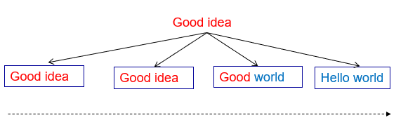
Stable storage（假想性的）: 为了防止日志丢，会把日志记录在stable storage上
  a mythical神话 form of storage that survives all failures
  approximated by maintaining multiple copies on distinct nonvolatile media
在每个上都一致才认为真正一致

Slide 8
Log File Example（流水账，在stable storage上）
    <T1 start>
    <T1, A, 200, 100>
    <T2 start>
    <T2, B, 300, 200>
    <T3 start>
    <T1, C, 300, 400>
    <T1 commit>
    <T4 start>
    <T3, C, 400, 500>
    <T3 commit>
    <T2, C, 500, 600>
    <T4, A, 100, 700>
    <T2, C, 500>
    <T2, B, 300>
    <T2 abort>
    <T4, A, 100>
    <T4 abort>
Redo Pass：
重演历史
Undo Pass
compensation log
(补偿日志)
T2 rollback during
normal processing
T4 undone during
recovery
Undo list: {T4}

Slide 9
Write-Ahead Logging (先写日志原则)
Write-Ahead Logging or WAL(先写日志原则):
主存中的数据在输出到数据库之前，与数据相关的日志记录必须已经输出到stable storage
日志中写入commit的时候视为一个事务被提交了，但此时buffer中可能还在进行write操作，因为log的写入先于操作

Slide 10
Concurrency Control and Recovery
所有事务共用一个日志和disk buffer
假设如果一个事务改变了某个数据项，其他的事务直到这个事务commit或者abort之前都不能改变这个数据项的值
  Can be ensured by obtaining exclusive locks on updated items and holding the locks till end of transaction没有commited的事务引起的更新不能被其他事务更新(strict two-phase locking)
日志中不同事务的日志可能会相交Recovery with logical undo logging supports early lock release.

Slide 11
Transaction Commit
当一个事务的提交日志记录输出到stable storage时，就说该事务已提交之前的所有日志记录必须已经输出
事务执行的写在事务提交时可能仍在缓冲区buffer中，并可能稍后输出

Slide 12
Undo(撤销) and Redo（重做） Operations
Undo of a log record <T_{i}, X, V₁, V₂> writes the old value V₁ to X
Redo of a log record <T_{i}, X, V₁, V₂> writes the new value V₂ to X
Undo and Redo of Transactions
  undo(T_{i}) restores the value of all data items updated by T_{i} to their old values, going backwards from the last log record for T_{i}
    each time a data item X is restored to its old value V a special log record <T_{i} , X, V> is written out – compensation log(补偿日志)
    when undo of a transaction is complete, a log record
    <T_{i} abort> is written out.
  redo(T_{i}) sets the value of all data items updated by T_{i} to the new values, going forward from the first log record for T_{i}
    No logging is done in this case

Slide 13
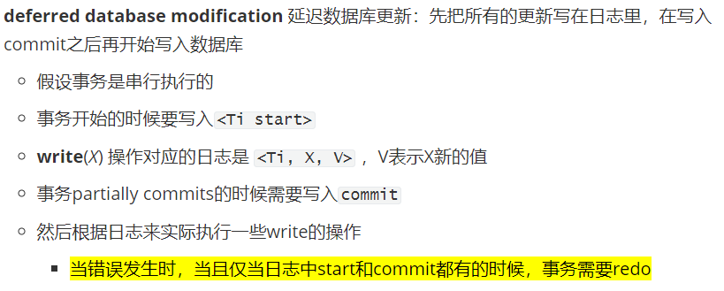

Slide 14
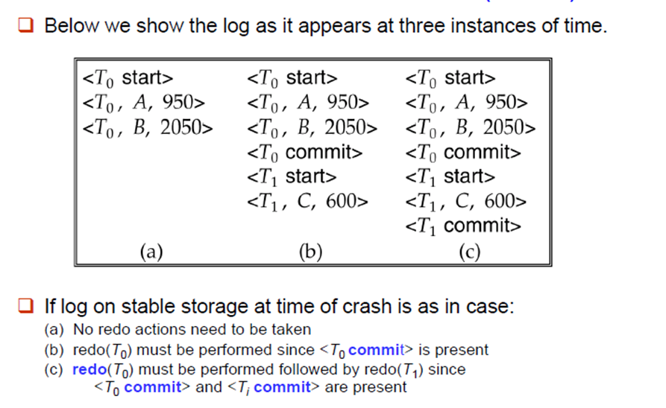

Slide 15
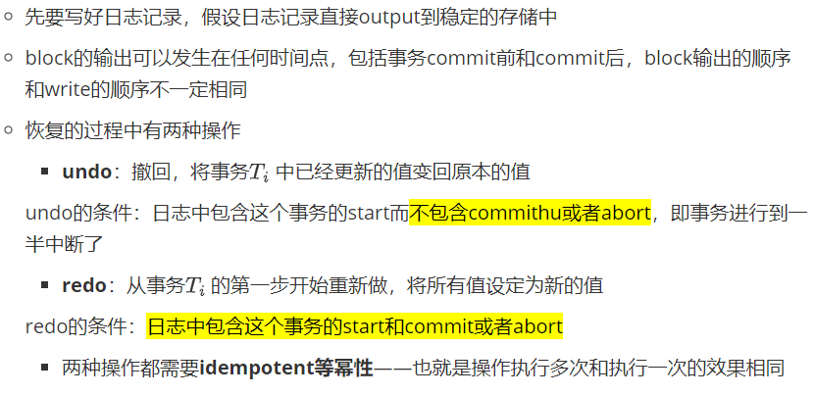
immediate database modification
直接修改数据库

Slide 16

（Immediate） DB Modification Recovery Example
Below we show the log as it appears at three instances of time.
Recovery actions in each case above are:
(a) undo (T₀): B is restored to 2000 and A to 1000, and log records
<T₀, B, 2000>, <T₀, A, 1000>, <T₀, abort> are written out
(b) redo (T₀) and undo (T₁): A and B are set to 950 and 2050 and C is restored to 700. Log records <T₁, C, 700>, <T₁, abort> are written out.
(c) redo (T₀) and redo (T₁): A and B are set to 950 and 2050
respectively. Then C is set to 600

Slide 17

Checkpoints

Slide 18
通过checkpoint，在日志处理的时候就不需要处理所有的日志，只需要关注异常时正在活跃的事务，恢复的步骤如
  从日志的末尾向前扫描，直到发现最近的checkpoint记录
  只有L中记录的，或者在L之后发生的事务需要redo或者undo
  checkpoint之前的记录已经生效并保存在了稳定的存储中
日志中更早的部分或许需要undo，但一定不需要redo
  继续向前扫描直到发现一个事务的start日志
  最早的start之前的日志不需要进行恢复操作，并且可以清除

Slide 19
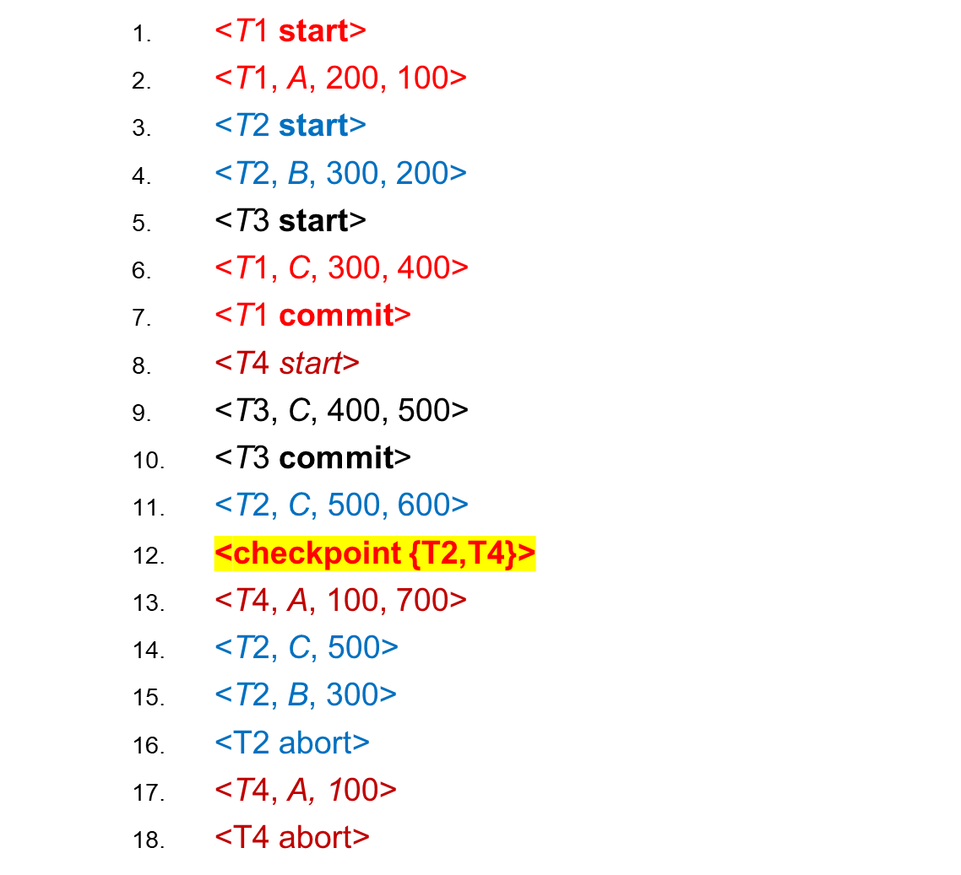
Log File with Checkpoint : Example
历史只需要从这里开始重演
Undo Pass
Redo Pass
compensation log
(补偿日志)
T2 rollback during
normal processing
T4 undone during
recovery
Undo list：{T4}
Notes:
根据时间或者日志量来确定checkpoints

Slide 20
Recovery Algorithm
Transaction rollback (during normal operation)
  Let T_{i} be the transaction to be rolled back
  Scan log backwards from the end, and for each log record of T_{i} of the form <T_{i}, X_{j}, V₁, V₂>
    修改回原本的值：V₁ to X_{j},
    write a log record <T_{i} , X_{j}, V₁>
      such log records are called compensation log records(补偿记录)
  Once the record <T_{i} start> is found stop the scan and write the log record <T_{i} abort>

Slide 21
Recovery from failure: Two phases
  Redo phase: replay updates of all transactions, whether they committed, aborted, or are incomplete –repeating history !!!
  Undo phase: undo all incomplete transactions
Redo phase:
  Find last <checkpoint L> record, and set undo-list to L.
  Scan forward from above <checkpoint L> record
    Whenever a record <T_{i}, X_{j}, V₁, V₂> is found, redo it by writing V₂ to X_{j}
    Whenever a (compensation) log record <Ti, Xj, V2> is found, redo it by writing V2 to Xj
    Whenever a log record <T_{i} start> is found, add T_{i} to undo-list
    Whenever a log record <T_{i} commit> or <T_{i} abort> is found, remove T_{i} from undo-list

Slide 22
Undo phase:
  Scan log backwards from end
    Whenever a log record <T_{i}, X_{j}, V₁, V₂> is found where T_{i} is in undo-list perform same actions as for transaction rollback:
      perform undo by writing V₁ to X_{j}.
      write a log record <T_{i} , X_{j}, V₁>
    Whenever a log record <T_{i} start> is found where T_{i} is in undo-list,
      Write a log record <T_{i} abort>
      Remove T_{i} from undo-list
    Stop when undo-list is empty
      i.e. <T_{i} start> has been found for every transaction in undo-list
After undo phase completes, normal transaction processing can commence

Slide 23

Example of Recovery

Slide 24


Log Buffer & Database Buffer
Transactions
Main Memory
read/write
日志缓冲区
database buffer
log buffer
input/output
Log Writer
Database
Log File
Disk
database
log file

Slide 25
Log Record Buffering
Log record buffering: log records are buffered in main memory, instead of of being output directly to stable storage. 以块为单位存日志
  Log records are output to stable storage when a block of log records in the buffer is full, or a log force operation is executed.
Log force is performed to commit a transaction by forcing all its log records (including the commit record) to stable storage.
Group commit : several log records can be output using a single output operation, reducing the I/O cost.

Slide 26
The rules below must be followed if log records are buffered:
  Log records are output to stable storage in the order in which they are created.
  Transaction T_{i} enters the commit state only when the log record
  <T_{i} commit> has been output to stable storage.
  Before a block of data in main memory is output to the database, all log records pertaining to data in that block must have been output to stable storage.
    This rule is called the write-ahead logging or WAL rule
      Strictly speaking WAL only requires undo information to be output

Slide 27
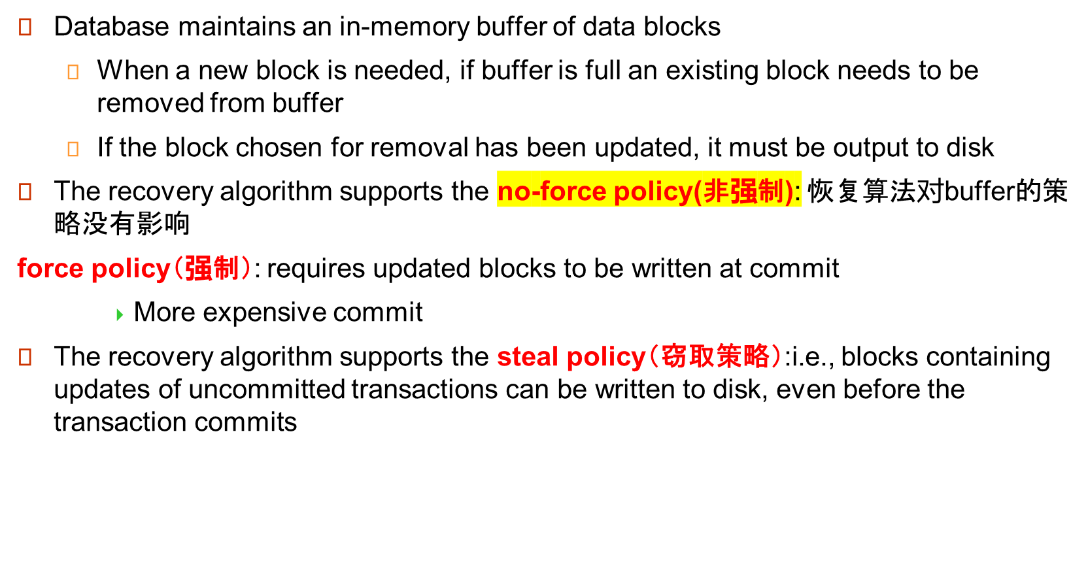
Database Buffering

Slide 28
Fuzzy Checkpointing 模糊检查点
To avoid long interruption of normal processing during checkpointing（刷写脏页的时候要把其他进程都停下）, allow updates to happen during checkpointing
Fuzzy checkpointing is done as follows:
  Temporarily stop all updates by transactions
  Write a <checkpoint L> log record and force log to stable storage
  Note list M of modified buffer blocks
  Now permit transactions to proceed with their actions
  Output to disk all modified buffer blocks in list M
    blocks should not be updated while being output
    Follow WAL: all log records pertaining to a block must be output before the block is output
  Store a pointer to the checkpoint record in a fixed position last_checkpoint on disk

Slide 29
When recovering using a fuzzy checkpoint, start scan from the checkpoint record pointed to by last_checkpoint
  Log records before last_checkpoint have their updates reflected in database on disk, and need not be redone.
  Incomplete checkpoints, where system had crashed while performing checkpoint, are handled safely
……
<checkpoint L>
…..
<checkpoint L>
…..
last_checkpoint
Log

Slide 30
Failure with Loss of Nonvolatile Storage
So far we assumed no loss of non-volatile storage
Technique similar to checkpointing used to deal with loss of non-volatile storage
  Periodically dump the entire content of the database to stable storage
  No transaction may be active during the dump procedure; a procedure similar to checkpointing must take place
    Output all log records currently residing in main memory onto stable storage.
    Output all buffer blocks onto the disk.
    Copy the contents of the database to stable storage.
    Output a record <dump> to log on stable storage.

Slide 31
Recovering from Failure of Non-Volatile Storage
To recover from disk failure
  restore database from most recent dump.
  Consult the log and redo all transactions that committed after the dump
Can be extended to allow transactions to be active during dump;
known as fuzzy dump or online dump
  Similar to fuzzy checkpointing， 相当于是一个快照

Slide 32
Recovery with Early Lock Release and Logical Undo Operations

Slide 33
Recovery with Early Lock Release
Support for high-concurrency locking techniques, such as those used for B⁺-tree concurrency control, which release locks early
  Supports “logical undo”
Recovery based on “repeating history”, whereby recovery executes exactly the same actions as normal processing

Slide 34
Logical Undo Logging
Operations like B⁺-tree insertions and deletions release locks early.
  They cannot be undone by restoring old values (physical undo), since once a lock is released, other transactions may have updated the B⁺-tree.
  Instead, insertions (resp. deletions) are undone by executing a deletion (resp. insertion) operation (known as logical undo).
For such operations, undo log records should contain the undo operation to be executed
  Such logging is called logical undo logging, in contrast to physical undo logging
    Operations are called logical operations
  Other examples:
    delete of tuple, to undo insert of tuple
      allows early lock release on space allocation information
    subtract amount deposited, to undo deposit
      allows early lock release on bank balance

Slide 35
Physical Redo
Redo information is logged physically (that is, new value for each write) even for operations with logical undo
  Logical redo is very complicated since database state on disk may not be “operation consistent” when recovery starts
  Physical redo logging does not conflict with early lock release

Slide 36
Operation Logging
Operation logging is done as follows:
  When operation starts, log <T_{i}, O_{j}, operation-begin>. Here O_{j} is a unique identifier of the operation instance.
  While operation is executing, normal log records with physical redo and physical undo information are logged.
  When operation completes, <T_{i}, O_{j}, operation-end, U> is logged, where U contains information needed to perform a logical undo information.
Example: insert of (key, record-id) pair (K5, RID7) into index I9
<T1, O1, operation-begin>
….
<T1, X, 10, K5>
<T1, Y, 45, RID7>
<T1, O1, operation-end, (delete I9, K5, RID7)>
Physical redo of steps in insert

Slide 37
Operation Logging (Cont.)
If crash/rollback occurs before operation completes:
  the operation-end log record is not found, and
  the physical undo information is used to undo operation.
If crash/rollback occurs after the operation completes:
  the operation-end log record is found, and in this case
  logical undo is performed using U; the physical undo information for the operation is ignored.
Redo of operation (after crash) still uses physical redo information.

Slide 38
Transaction Rollback with Logical Undo
Rollback of transaction T_{i} is done as follows:
Scan the log backwards
  If a log record <T_{i}, X, V₁, V₂> is found, perform the undo and log <T_{i}, X, V₁>.
  If a <T_{i}, O_{j}, operation-end, U> record is found
    Rollback the operation logically using the undo information U.
      Updates performed during roll back are logged just like during normal operation execution.
      At the end of the operation rollback, instead of logging an operation-end record, generate a record
    <T_{i}, O_{j}, operation-abort>.
    Skip all preceding log records for T_{i} until the record
    <T_{i}, O_{j} operation-begin> is found

Slide 39
Transaction Rollback with Logical Undo (Cont.)
Transaction rollback, scanning the log backwards (cont.):
  If a redo-only record is found ignore it
  If a <T_{i}, O_{j}, operation-abort> record is found:
    skip all preceding log records for T_{i} until the record
    <T_{i}, O_{j}, operation-begin> is found.
  Stop the scan when the record <T_{i}, start> is found
  Add a <T_{i}, abort> record to the log
Some points to note:
Cases 3 and 4 above can occur only if the database crashes while a transaction is being rolled back.
Skipping of log records as in case 4 is important to prevent multiple rollback of the same operation.

Slide 40
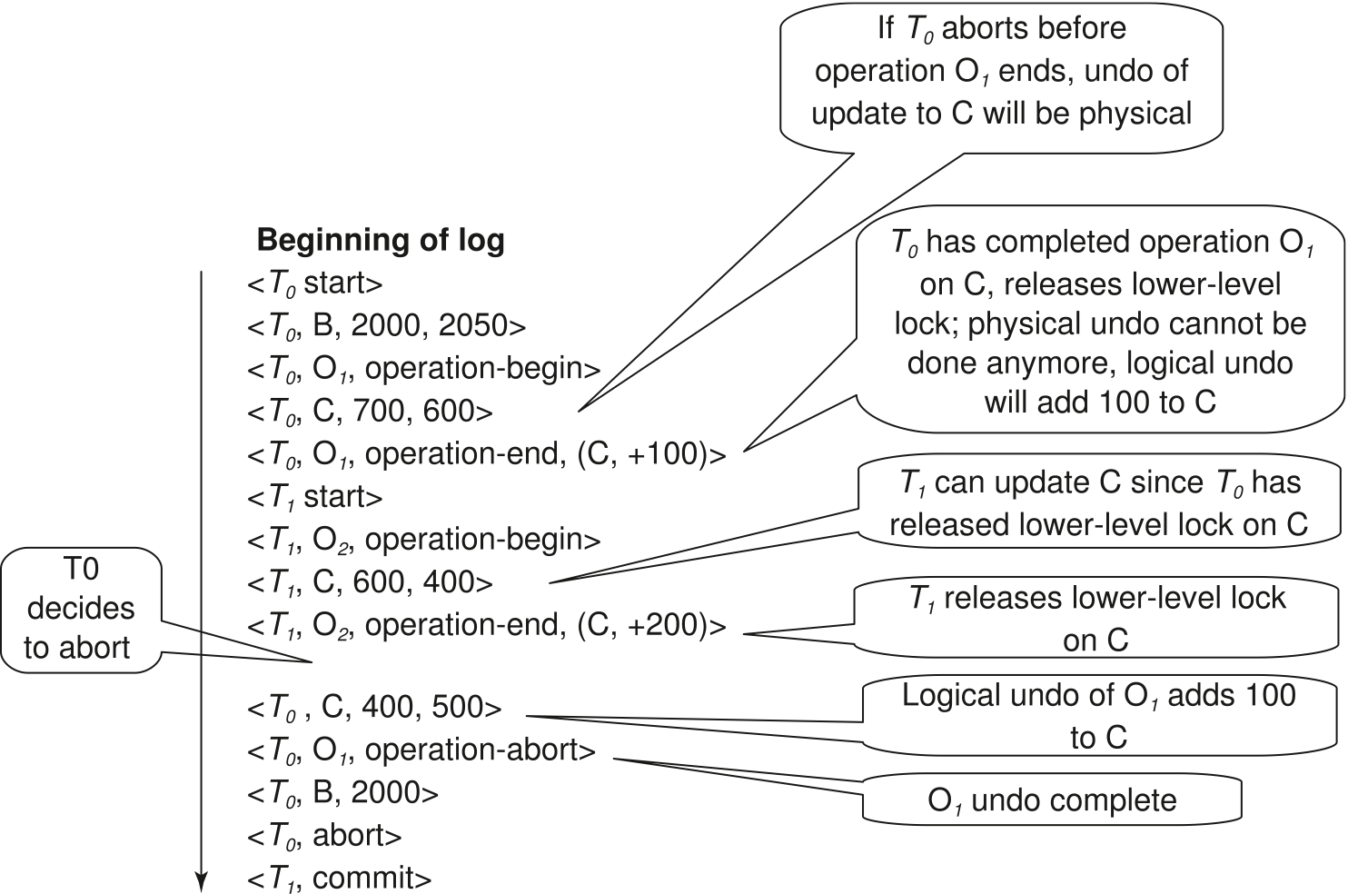
Transaction Rollback with Logical Undo
Transaction rollback during normal operation

Slide 41

Failure Recovery with Logical Undo
从最近的checkpoint开始做

Slide 42
Recovery Algorithm with Logical Undo
Basically same as earlier algorithm, except for changes described earlier for transaction rollback
(Redo phase): Scan log forward from last < checkpoint L> record till end of log
  Repeat history by physically redoing all updates of all transactions,
  Create an undo-list during the scan as follows
    undo-list is set to L initially
    Whenever <T_{i} start> is found T_{i} is added to undo-list
    Whenever <T_{i} commit> or <T_{i} abort> is found, T_{i} is deleted from undo-list
This brings database to state as of crash, with committed as well as uncommitted transactions having been redone.
Now undo-list contains transactions that are incomplete, that is, have neither committed nor been fully rolled back.

Slide 43
Recovery with Logical Undo (Cont.)
Recovery from system crash (cont.)
(Undo phase): Scan log backwards, performing undo on log records of transactions found in undo-list.
  Log records of transactions being rolled back are processed as described earlier, as they are found
    Single shared scan for all transactions being undone
  When <T_{i} start> is found for a transaction T_{i} in undo-list, write a <T_{i} abort> log record.
  Stop scan when <T_{i} start> records have been found for all T_{i} in undo-list
This undoes the effects of incomplete transactions (those with neither commit nor abort log records). Recovery is now complete.

Slide 44
ARIES Recovery Algorithm

Slide 45
ARIES
ARIES is a state of the art recovery method
  Incorporates numerous optimizations to reduce overheads during normal processing and to speed up recovery
  The recovery algorithm we studied earlier is modeled after ARIES, but greatly simplified by removing optimizations
Unlike the recovery algorithm described earlier, ARIES
  Uses log sequence number (LSN) to identify log records
    Stores LSNs in pages to identify what updates have already been applied to a database page
  Physiological redo
  Dirty page table to avoid unnecessary redos during recovery
  Fuzzy checkpointing that only records information about dirty pages, and does not require dirty pages to be written out at checkpoint time
    More coming up on each of the above …

Slide 46
ARIES Data Structures
ARIES uses several data structures
  Log sequence number (LSN) identifies each log record
    Must be sequentially increasing
    Typically an offset from beginning of log file to allow fast access
      Easily extended to handle multiple log files
  Page LSN
  Log records of several different types
  Dirty page table

Slide 47
ARIES Data Structures: Page LSN
Each page contains a PageLSN which is the LSN of the last log record whose effects are reflected on the page
  To update a page:
    X-latch the page, and write the log record
    Update the page
    Record the LSN of the log record in PageLSN
    Unlock page
  To flush page to disk, must first S-latch page
    Thus page state on disk is operation consistent
      Required to support physiological redo
  PageLSN is used during recovery to prevent repeated redo
    Thus ensuring idempotence

Slide 48
ARIES Data Structures: Log Record
Each log record contains LSN of previous log record of the same transaction
  LSN in log record may be implicit
Special redo-only log record called compensation log record (CLR) used to log actions taken during recovery that never need to be undone
  Serves the role of operation-abort log records used in earlier recovery algorithm
  Has a field UndoNextLSN to note next (earlier) record to be undone
    Records in between would have already been undone
    Required to avoid repeated undo of already undone actions
LSN TransID PrevLSN RedoInfo UndoInfo
LSN TransID UndoNextLSN RedoInfo
1
2
3
4
4'
3'
2'
1'

Slide 49
ARIES Data Structures: DirtyPage Table
DirtyPageTable
  List of pages in the buffer that have been updated
  Contains, for each such page
    PageLSN of the page
    RecLSN is an LSN such that log records before this LSN have already been applied to the page version on disk
      Set to current end of log when a page is inserted into dirty page table (just before being updated)
      Recorded in checkpoints, helps to minimize redo work

Slide 50
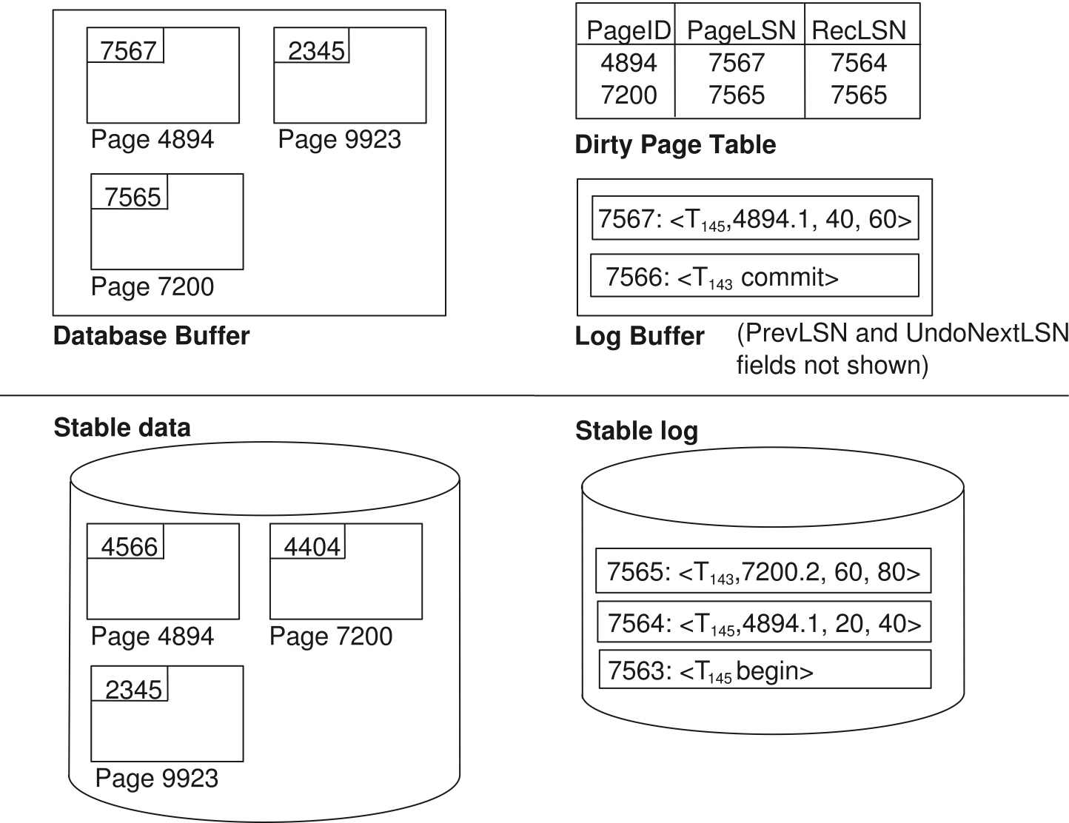
ARIES Data Structures

Slide 51
ARIES Data Structures: Checkpoint Log
Checkpoint log record
  Contains:
    DirtyPageTable and list of active transactions
    For each active transaction, LastLSN, the LSN of the last log record written by the transaction
  Fixed position on disk notes LSN of last completed
  checkpoint log record
Dirty pages are not written out at checkpoint time
    Instead, they are flushed out continuously, in the background
Checkpoint is thus very low overhead
  can be done frequently

Slide 52
ARIES Recovery Algorithm
ARIES recovery involves three passes
Analysis pass: Determines
  Which transactions to undo (undo-list)
  Which pages were dirty (disk version not up to date) at time of crash
  RedoLSN: LSN from which redo should start
Redo pass:
  Repeats history, redoing all actions from RedoLSN
    RecLSN and PageLSNs are used to avoid redoing actions already reflected on page
Undo pass:
  Rolls back all incomplete transactions
    Transactions whose abort was complete earlier are not undone
      Key idea: no need to undo these transactions: earlier undo actions were logged, and are redone as required

Slide 53
ARIES Data Structures
Dirty Page Table
PageLSN
PageID PageLSN RecLSN
P1 22 20
P2 21 21
P3 19 19
P1 22
P2 21
P3 19
Buffer Pool
LSN PrevLSN TNO TYPE PID len offset before after
T1 U P1 3 21 ABC DEF
T2 U P3 3 41 HIJ KLM
17 16 T2 U P1 3 20 GDE QRS
18 15 T1 U P2 3 21 TUV WXY
19 T3 U P3 3 51 COM EDU
20 17 T2 U P1 3 30 EDU ORG
21 19 T3 U P2 3 60 SCI ART
22 18 T1 U P1 3 30 ORG COM
23 BEGIN_C
24 END_CKP{P1:20,P2:21,P3:19} {T1:22,T2:20,T3:21}
Active TXN Table
Tno LastLSN
T1 22
T2 20
T3 21
P1 17
P3 16
P2 18
P4 10
Page LSNs on disk
Notes:
（下一页的）系统crash之后，analysis过程首先先得到本页的Dirty Page Table和Active TXN Table, 并且RedoLSN=min（20，21，19）=19。之后分析本CKP 日志之后的日志项目，更新Dirty Page Table和Active TXN Table.

Slide 54
ARIES Data Structures(cont.)
Dirty Page Table
PageLSN
Page PageLSN RecLSN
P1 22 20
P2 21 21
P3 19 19
P4 27 27
P1 22
P2 21
P3 19
P4 27
Buffer Pool
LSN PrevLSN TNO TYPE PID len offset before after
15 ┬ T1 U P1 3 21 ABC DEF
16 ┬ T2 U P3 3 41 HIJ KLM
17 16 T2 U P1 3 20 GDE QRS
18 15 T1 U P2 3 21 TUV WXY
19 ┬ T3 U P3 3 51 COM EDU
20 17 T2 U P1 3 30 EDU ORG
21 19 T3 U P2 3 60 SCI ART
22 18 T1 U P1 3 30 ORG COM
23 BEGIN_C
24 END_CKP{P1:20,P2:21,P3:19} {T1:22,T2:20,T3:21}
25 22 T1 C
25 T1 E
27 20 T2 U P4 3 40 XYX ABC
Active TXN Table
Tno LastLSN
T2 27
T3 21
P1 17
P3 16
P2 18
P4 10
Page LSNs on disk
Notes:
（本页的）系统crash之后：
Analysis过程，首先从最近的CKP日志得到上页的Dirty Page Table和Active TXN Table, 并且RedoLSN=min（20，21，19）=19。之后分析CKP 日志之后的日志项，更新Dirty Page Table（由于日志27而增加P4）和Active TXN Table（由于日志26而删除T1，并且由于日志27而更新T3的LatsLSN）
Read过程，repeat history,回复Crash时的“现场”，如本页的Buffer Pool. 其中只有P1需要redo, 因为日志22的LSN大于P1回复前的20,从磁盘中读取P1:17, 所以需要更新。
Undo过程：需要undoT2,T3 依次undo 27→21→20→ 19→17→16

Slide 55
Aries Recovery: 3 Passes
Analysis, redo and undo passes
Analysis determines where redo should start
Undo has to go back till start of earliest incomplete transaction
Last checkpoint
End of Log
Time
Log
Analysis pass
Redo pass
Undo pass

Slide 56
ARIES Recovery: Analysis
Analysis pass
Starts from last complete checkpoint log record
  Reads DirtyPageTable from log record
  Sets RedoLSN = min of RecLSNs of all pages in DirtyPageTable
    In case no pages are dirty, RedoLSN = checkpoint record’s LSN
  Sets undo-list = list of transactions in checkpoint log record
  Reads LSN of last log record for each transaction in undo-list from checkpoint log record
Scans forward from checkpoint
.. Cont. on next page …

Slide 57
ARIES Recovery: Analysis (Cont.)
Analysis pass (cont.)
Scans forward from checkpoint
  If any log record found for transaction not in undo-list, adds transaction to undo-list
  Whenever an update log record is found
    If page is not in DirtyPageTable, it is added with RecLSN set to LSN of the update log record
  If transaction end log record found, delete transaction from undo-list
  Keeps track of last log record for each transaction in undo-list
    May be needed for later undo
At end of analysis pass:
  RedoLSN determines where to start redo pass
  RecLSN for each page in DirtyPageTable used to minimize redo work
  All transactions in undo-list need to be rolled back

Slide 58
ARIES Redo Pass
Redo Pass:
Repeats history by replaying every action not already reflected in the page on disk, as follows:
Scans forward from RedoLSN. Whenever an update log record is found:
  If the page is not in DirtyPageTable or the LSN of the log record is less than the RecLSN of the page in DirtyPageTable, then skip the log record
  Otherwise fetch the page from disk. If the PageLSN of the page fetched from disk is less than the LSN of the log record, redo the log record
  NOTE: if either test is negative the effects of the log record have already appeared on the page. First test avoids even fetching the page from disk!

Slide 59
ARIES Undo Actions
When an undo is performed for an update log record
  Generate a CLR containing the undo action performed (actions performed during undo are logged physicaly or physiologically).
    CLR for record n noted as n’ in figure below
  Set UndoNextLSN of the CLR to the PrevLSN value of the update log record
    Arrows indicate UndoNextLSN value
ARIES supports partial rollback
  Used e.g. to handle deadlocks by rolling back just enough to release reqd. locks
  Figure indicates forward actions after partial rollbacks
    records 3 and 4 initially, later 5 and 6, then full rollback
1
2
3
4
4'
3'
5
6
6'
5'
1'
2'

Slide 60
ARIES: Undo Pass
Undo pass:
Performs backward scan on log undoing all transaction in undo-list
  Backward scan optimized by skipping unneeded log records as follows:
    Next LSN to be undone for each transaction set to LSN of last log record for transaction found by analysis pass.
    At each step pick largest of these LSNs to undo, skip back to it and undo it
    After undoing a log record
      For ordinary log records, set next LSN to be undone for transaction to PrevLSN noted in the log record
      For compensation log records (CLRs) set next LSN to be undo to UndoNextLSN noted in the log record
        All intervening records are skipped since they would have been undone already
Undos performed as described earlier

Slide 61
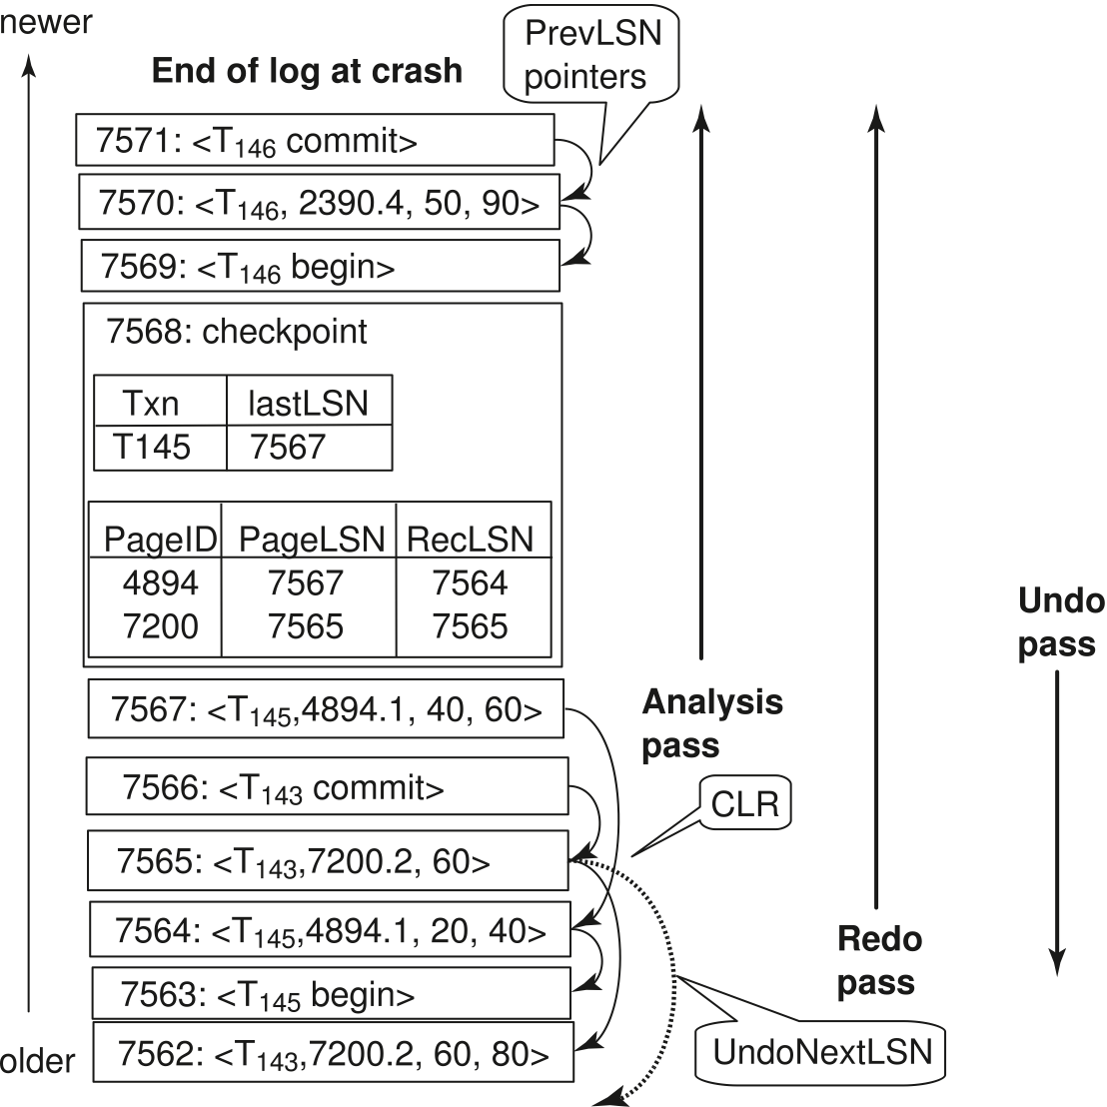
Recovery Actions in ARIES
Notes:
7564的修改就没有记录进去

